Slide 1


UNIVERSITY TIME TABLE SCHEDULING
USING GRAPH COLORING

Slide 2
MADE BY -
Kushagra Keserwani
2K19/IT/070
and
Ishaan Jaggi
2K19/IT/062
Under the guidance of -
Ms. Swati Sharda

Slide 3
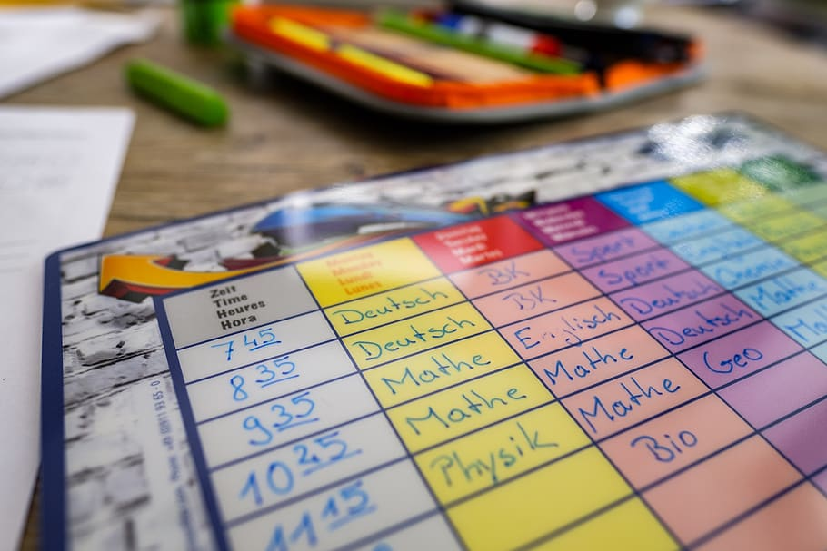
OBJECTIVE
This application provides a complete course Time table for each year of university satisfying the constraints below:
Course having a common student or such constraints must not be scheduled in the same slot
Number of slots available in a day
Number of credits a course holds (Number of classes to be held in a week for a course)
It will also allot a room to the slot such that no two courses having the same slot are taught in same room.

Slide 4
PROPOSED INPUT FORMAT
For which year:-
Enter the number of subjects:-
Enter the subjects, codes and credits -
(Checkbox or button) Each student will study each course
4
10
Subjects | Eng. | Maths | CS | Hindi | Phy. | Chem. | French | DS | Elect. | Mech.
Code | 29 | 30 | 31 | 32 | 33 | 34 | 35 | 36 | 37 | 38
Credits | 5 | 2 | 4 | 5 | 2 | 4 | 5 | 2 | 4 | 5

Slide 5
 | Eng. | Maths | CS | Hindi | Phy. | Chem. | French | DS | Elect. | Mech.
Eng. | N | N | N |  |  |  |  |  |  | N
Maths | N | N | N |  |  |  |  |  |  | N
CS | N | N | N |  |  |  |  |  |  | N
Hindi |  |  |  | N | N | N |  |  |  | N
Phy. |  |  |  | N | N | N |  |  |  | N
Chem. |  |  |  | N | N | N |  |  |  | N
French |  |  |  |  |  |  | N | N | N | N
DS |  |  |  |  |  |  | N | N | N | N
Elect. |  |  |  |  |  |  | N | N | N | N
Mech. | N | N | N | N | N | N | N | N | N | N

Slide 6
GRAPH :--
29
37
38
36
30
31
35
33
32
34

Slide 7
PROPOSED OUTPUT FORMAT

Slide 8
4th Year | Mon | Tue | Wed | Thu | Fri
S1 | English R8 Hindi R9 French R10 | English R8 Hindi R9 French R10 | English R8 Hindi R9 French R10 | English R8 Hindi R9 French R10 | English R8 Hindi R9 French R10
S2 | -- | Maths R8 Physics R9 DS R10 | -- | Maths R8 Physics R9 DS R10 | --
S3 | -- | CS R6 Chemistry R7 Electrical R8 | CS R6 Chemistry R7 Electrical R8 | CS R6 Chemistry R7 Electrical R8 | CS R6 Chemistry R7 Electrical R8
S4 | Mechanical R6 | Mechanical R6 | Mechanical R6 | Mechanical R6 | Mechanical R6

Slide 9
METHODOLOGY
Take the input from the user the number of courses (subjects) for each year along with their names, codes and credits.
Also ask user which courses cannot be scheduled in the same slot.
Make a graph for every year with courses as vertices and an edge between courses which cannot be scheduled at the same time.
Now color the graph using NGC algorithm. The courses having same color can be scheduled in the same slot.
Courses are sorted in a way such that ones belonging to the same slot are separated for every slot and room numbers are allotted accordingly.
Build a user friendly user interface to take input and display output.

Slide 10
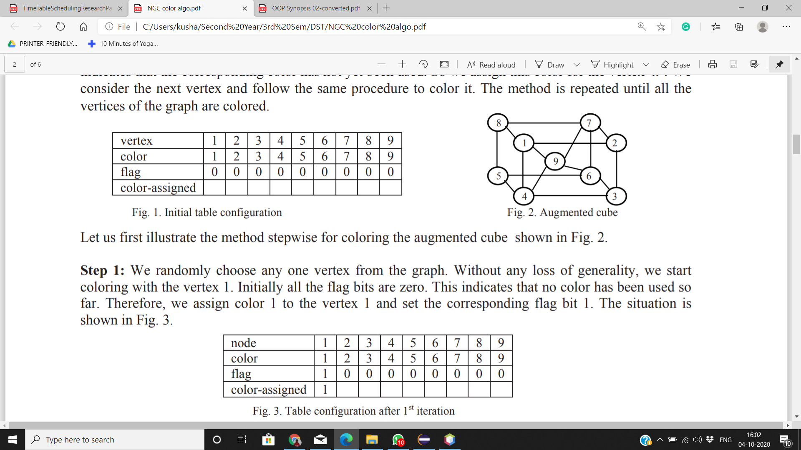
ALGORITHM
NGC algorithm is applied on the input graph as shown in the given example:-
We maintain a table having the four attributes namely, vertex, color, flag and color-assigned. The initial configuration of this table is shown in Fig. 1. We assume that the number of colors available is equal to the number of the nodes of the graph.

Slide 11
ALGORITHM
2. We randomly choose any one vertex from the graph. Without any loss of generality, we start coloring with the vertex 1. Initially all the flag bits are zero. This indicates that no color has been used so far. Therefore, we assign color 1 to the vertex 1 and set the corresponding flag bit 1. The situation is shown in Fig. 3.

Slide 12
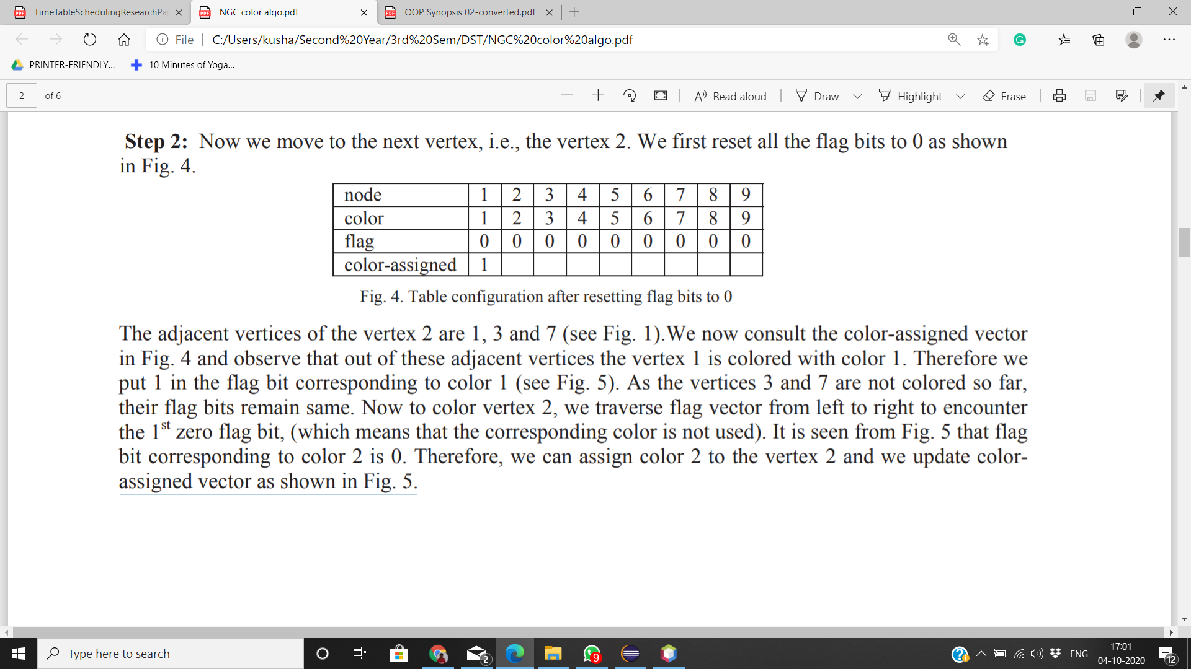
ALGORITHM
3. Now we move to the vertex 2. We first reset all the flag bits to 0 as shown in Fig. 4.
The adjacent vertices of the vertex 2 are 1, 3 and 7 .We now consult the color-assigned vector in Fig. 4 and observe that out of these adjacent vertices the vertex 1 is colored with color 1. Therefore we put 1 in the flag bit corresponding to color 1 (see Fig. 5). As the vertices 3 and 7 are not colored so far, their flag bits remain same.

Slide 13
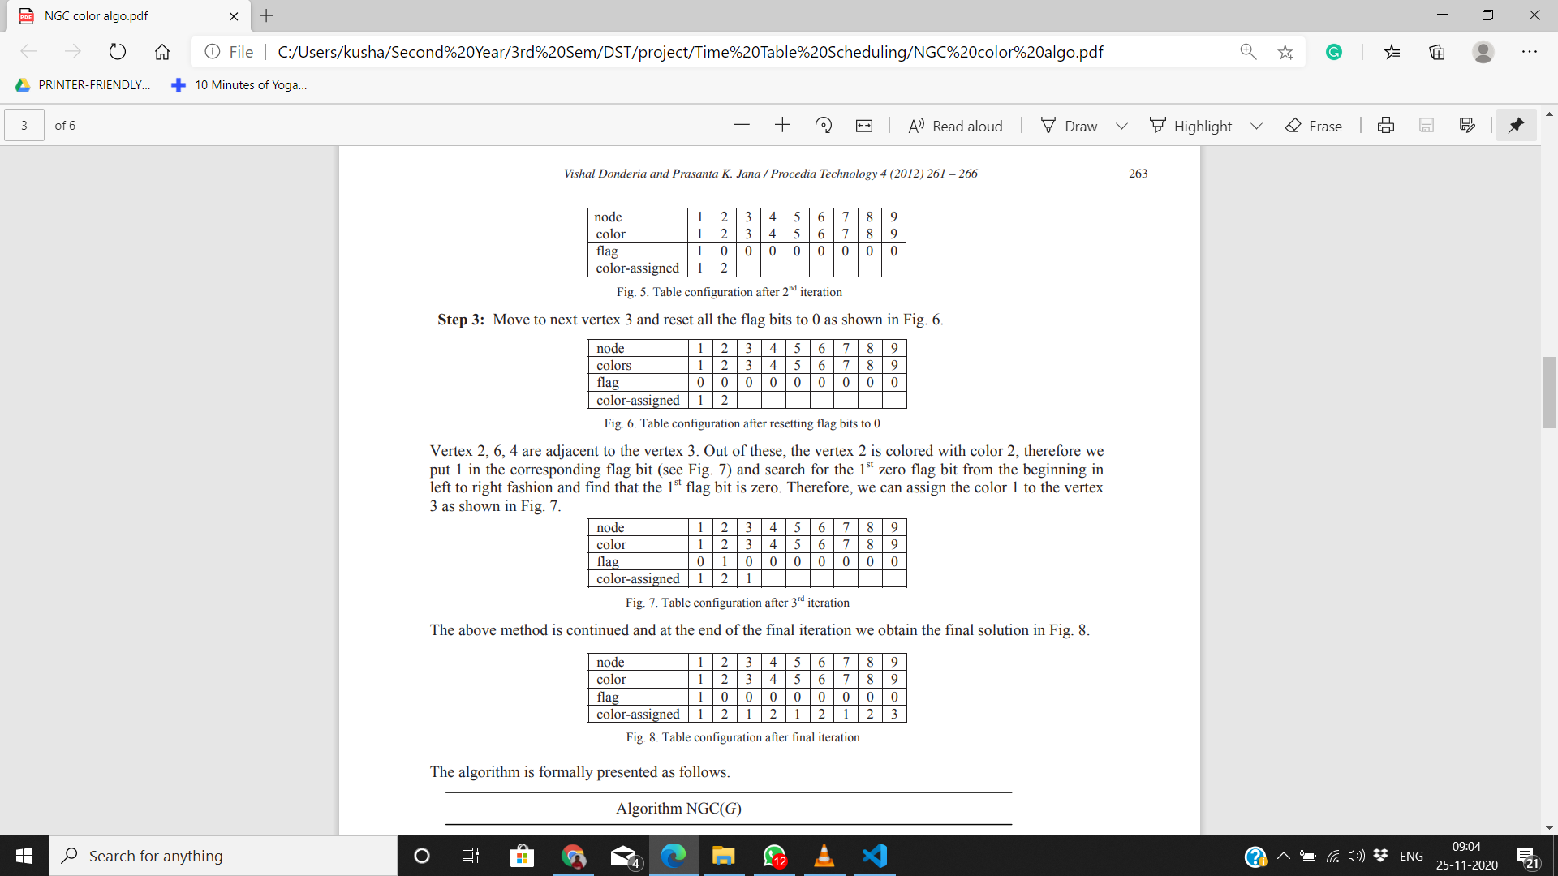
ALGORITHM
Now to color vertex 2, we traverse flag vector from left to right to encounter the 1st zero flag bit, (which means that the corresponding color is not used). It is seen from Fig. 5 that flag bit corresponding to color 2 is 0. Therefore, we can assign color 2 to the vertex 2 and we update color-assigned vector as shown in Fig. 5.
4. Move to next vertex 3 and reset all the flag bits to 0 as shown in Fig. 6.

Slide 14
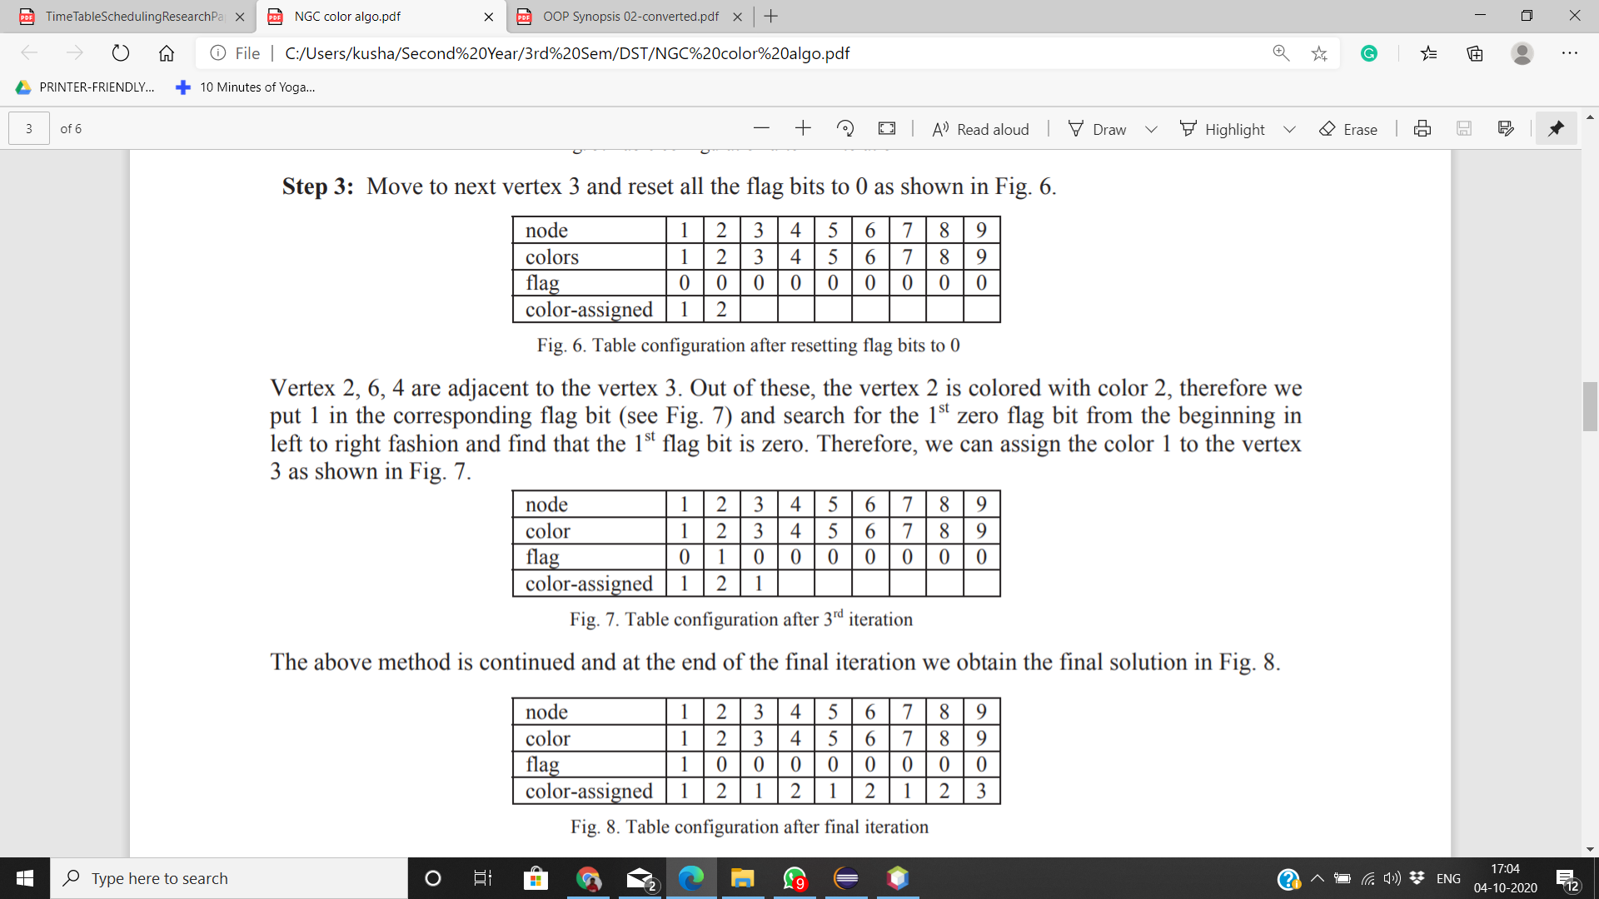
ALGORITHM
Vertex 2, 6, 4 are adjacent to the vertex 3. Out of these, the vertex 2 is colored with color 2, therefore we put 1 in the corresponding flag bit (see Fig. 7) and search for the 1st zero flag bit from left to right fashion and find that the 1st flag bit is zero. Therefore, we can assign the color 1 to the vertex 3 as shown in Fig. 7.
5. The above method is continued and at the end of the final iteration we obtain the final solution in Fig. 8.

Slide 15
CODE

Slide 16
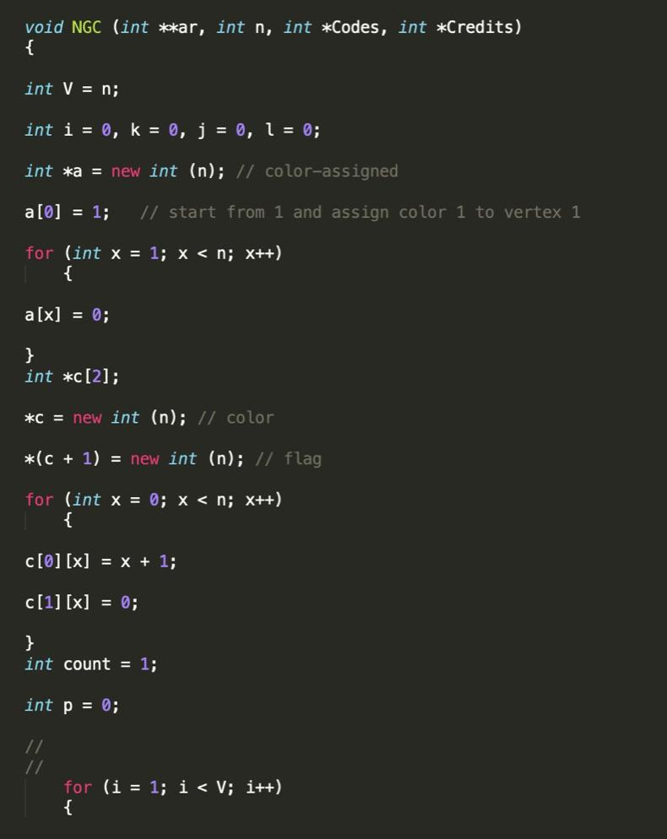
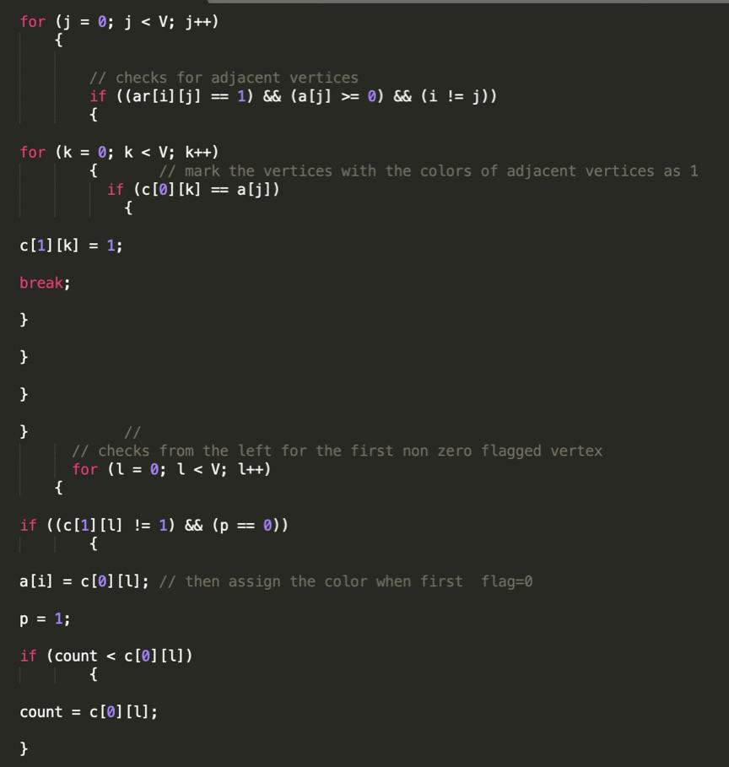
NGC ALGORITHM (CODE)..
1
2

Slide 17
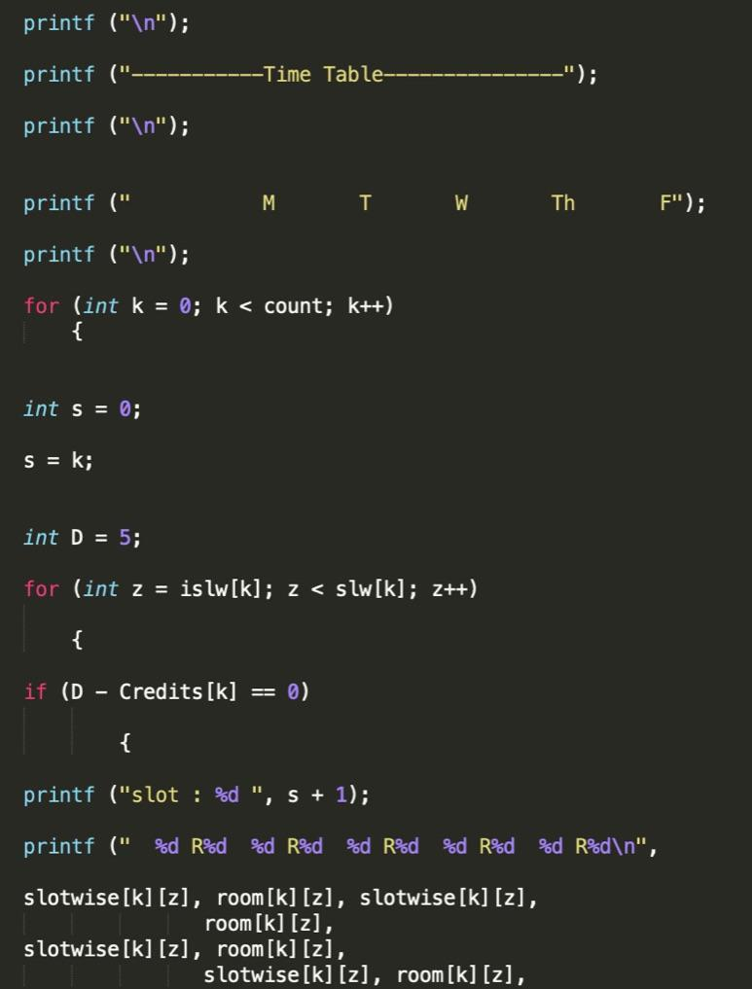
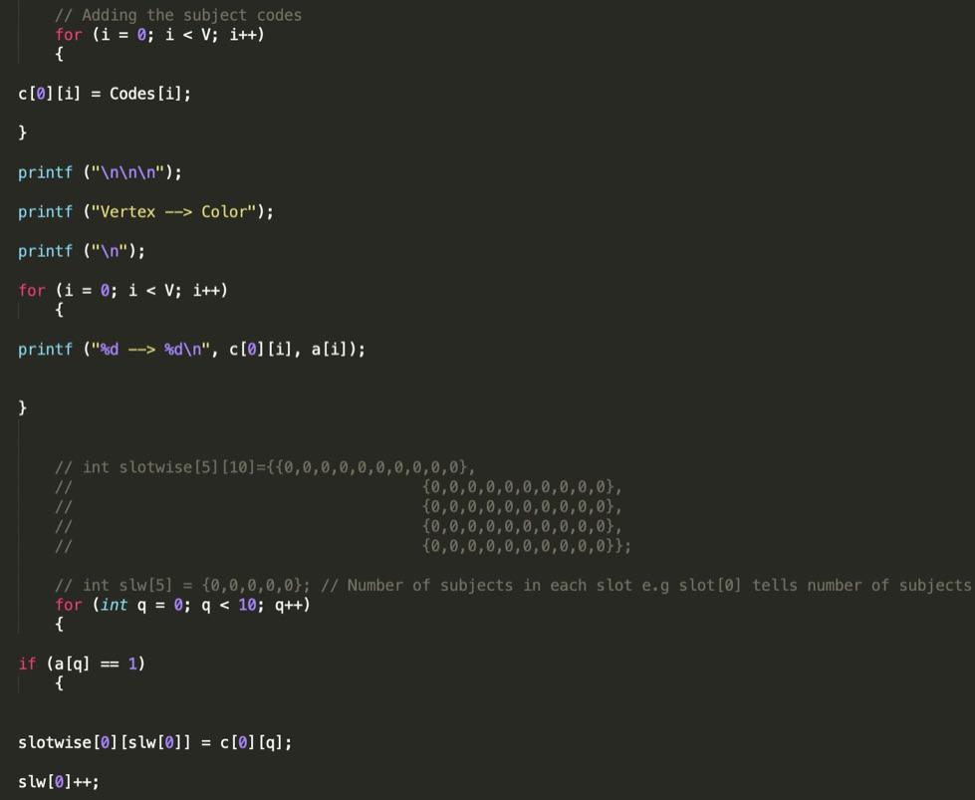
NGC ALGORITHM (CODE)..
3
4

Slide 18
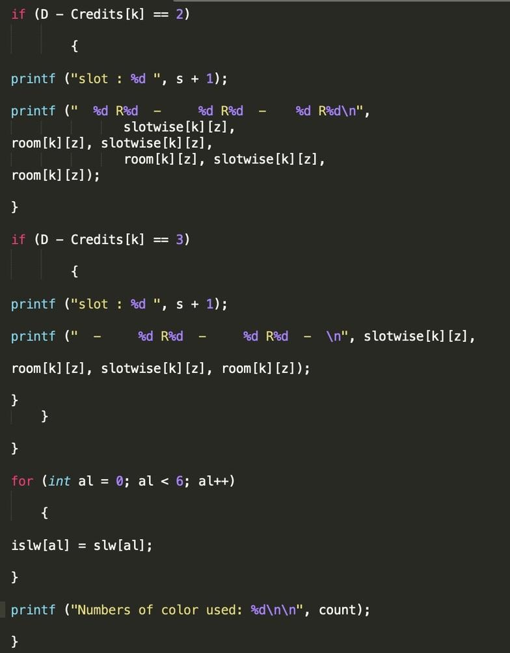
NGC ALGORITHM (CODE)..
5
These 5 snippets of code tell us about the implementation of NGC algorithm in our Project. This algorithm uses Subject Credits,Codes,slots etc and gives us the Scheduled Time-Table for the respective year entered as Output.
ORDER = 1 -> 2 -> 3 -> 4 -> 5

Slide 19
OUTPUT GENERATED..

Slide 20
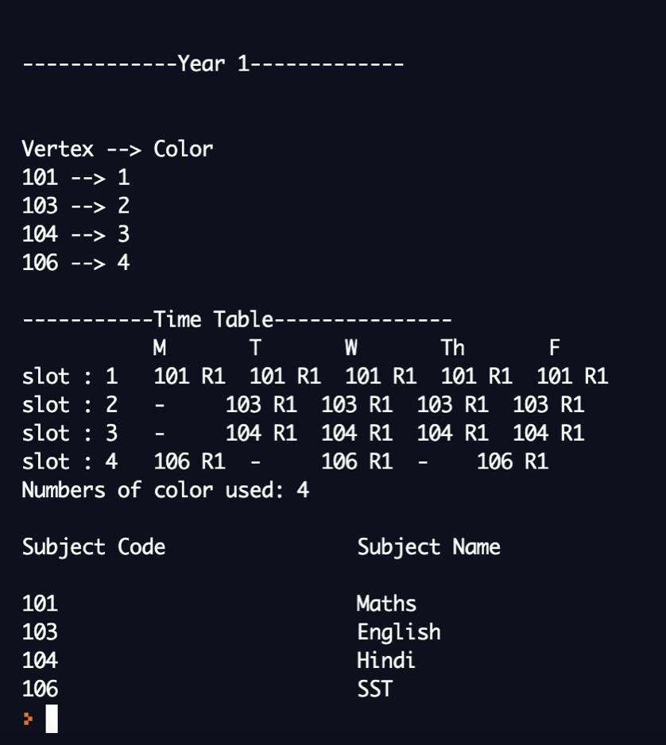
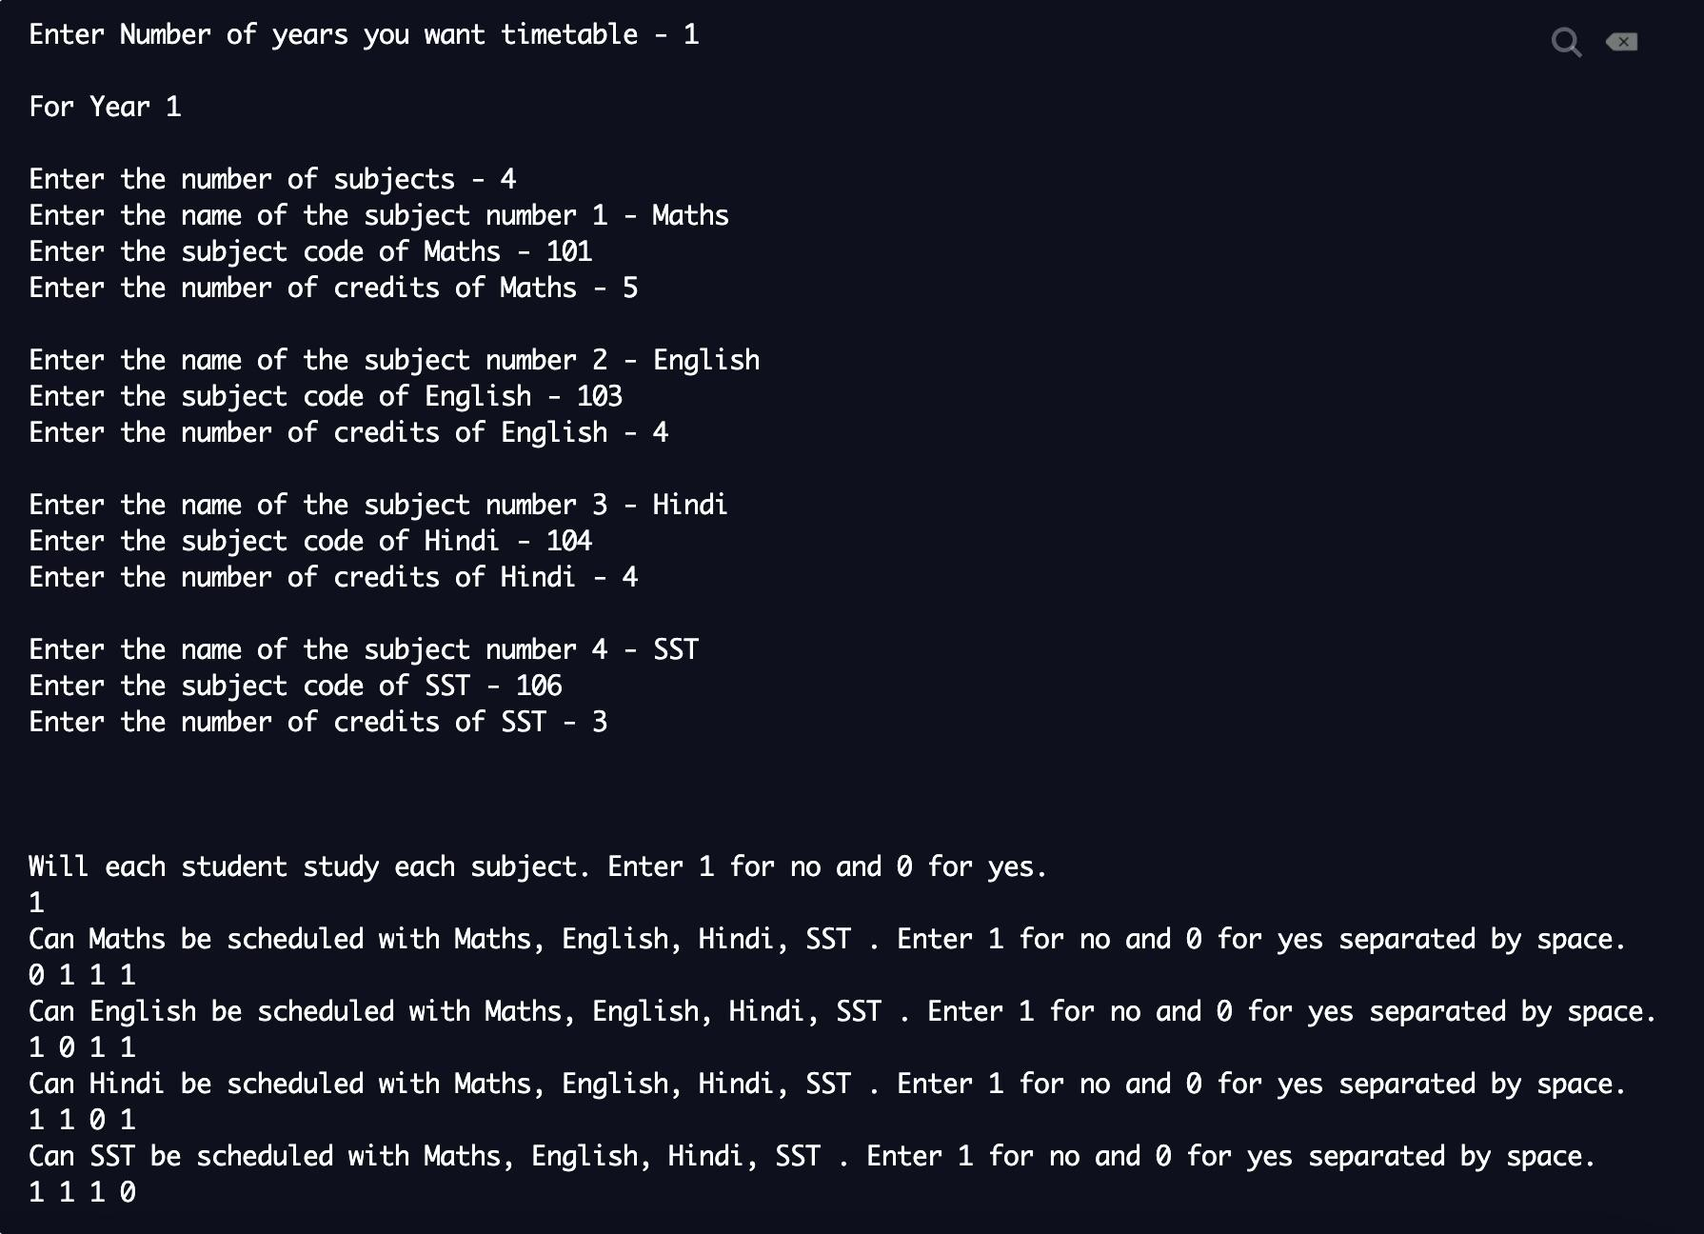
PROJECT CODE RESULTS..
1
INPUT
OUTPUT

Slide 21
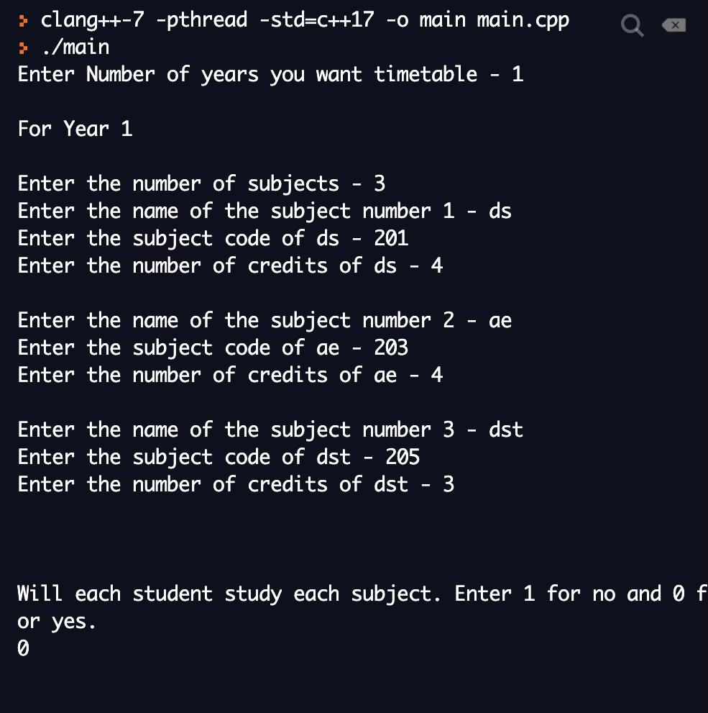
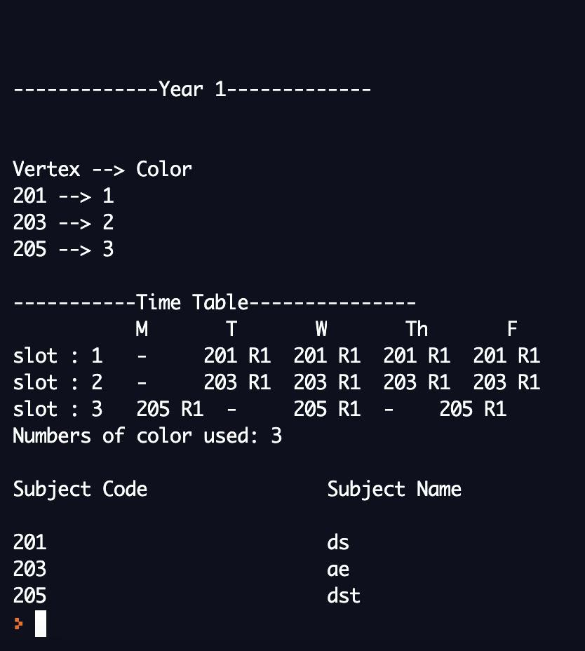
PROJECT CODE RESULTS..
2
INPUT
OUTPUT

Slide 22
THANK YOU..

